Slide 1
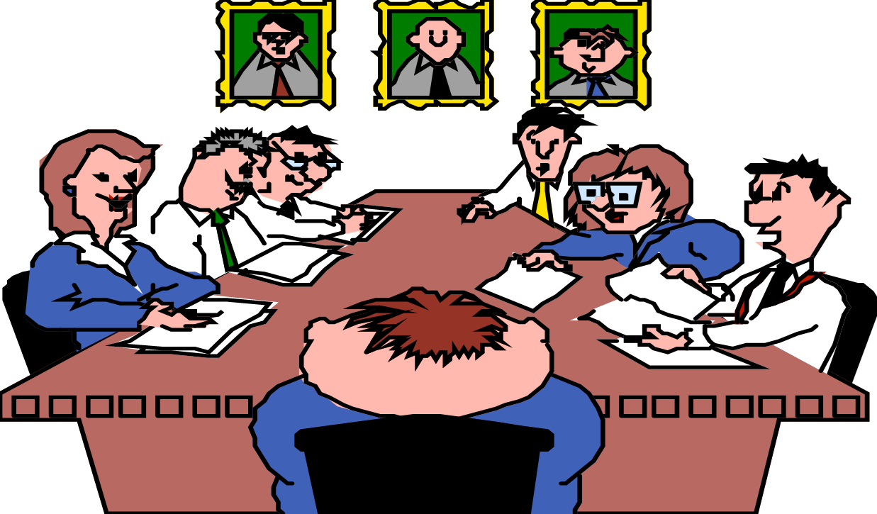
TEXT CLASSIFICATION
BY
TEAM TECH CONNECT
SIDAK
SUDHAKAR
SOURAV
SAMIKSHA
KOMAL
TAVLEEN

Slide 2

OVERVIEW
Words can harm, or words can heal. Unmeant words spoken can have devastating effect in someone's existence.
The advancement in technology has exposed people to serious risk of abuse online. Not all people on the Internet are interested in participating nicely, some perceive it as an avenue to vent their rage, insecurity, and prejudices.
Cyber-bullying causes significant emotional and psychological distress, leading to anxiety, fear, depression, and low self-esteem.
The cases of cyber-bullying are an area of concern
The need for a safe platform has increased all the more amidst this pandemic situation

Slide 3


process of assigning tags or categories to text according to its content
TEXT CLASSIFICATION
Toxic comment classification is basically a method of classifying a comment into toxic or non-toxic depending upon its inherent features.
The present task is an analysis of Wikipedia comments to create models that identify various types of toxic comments. For the purpose of this task, dataset from Kaggle has been used. The dataset has six labels that represent subcategories of toxicity i.e. threats, obscenity, insults, toxic, severe-toxic and identity-based hate.
NOTE
There is a lot of racist content and swear words in the dataset and some of it will pop up in the analysis.

Slide 4


PROBLEM STATEMENT
The goal is to create a classifier model that can predict if input text is inappropriate (toxic)
1. Explore the dataset to get a better picture of how the labels are distributed, how they correlate with each other, and what defines toxic or clean comments.
4. Build the final model with the best performing algorithm and parameters and test it on a holdout subset of the data.
2. Explore the effectiveness of multiple machine learning approaches and select the best for this problem.
3. Select the best model and tune the parameters to maximize performance.

Slide 5


DATASET
The dataset has been taken from . It consists of both training and test data.
DATASET
TRAIN
TEST
1,59,571
63,978
The test data is taken because the competition is over and hence, the correct labels have been released. Therefore, there was no need to split the train data further.

Slide 6

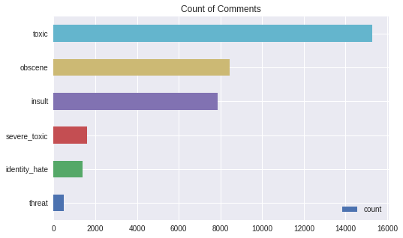
DATA ANALYSIS
The purpose of Data Analysis is to extract useful information from data and taking the decision based upon the data analysis
159,571 comments from Wikipedia
The dataset consists of one input feature, the string data for the comments, and six labels for different categories of toxic comments
LABELS

Slide 7
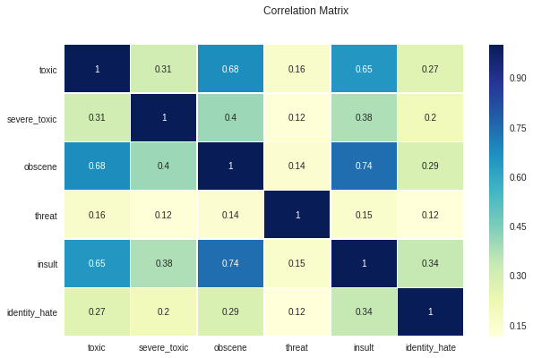
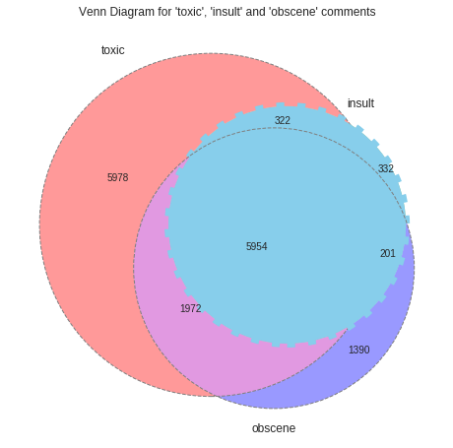
THE CORRELATION MATRIX AND VENN DIAGRAM PROVIDES MORE INSIGHT INTO THESE OVERLAPPING CATEGORIES

Slide 8
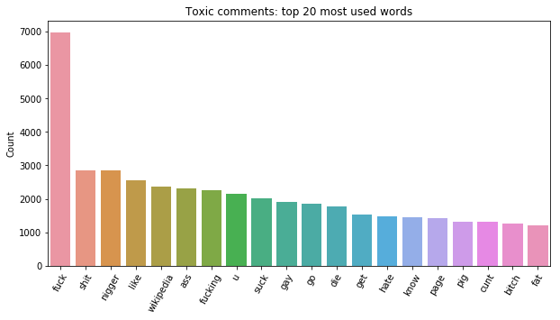
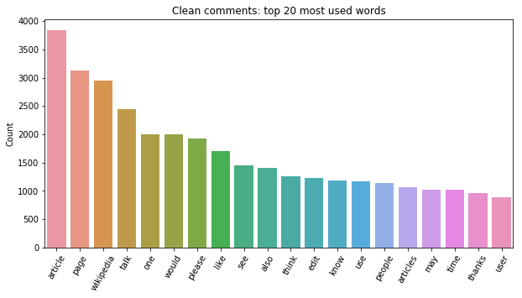
COMPARING VOCABULARY USAGE

Slide 9

SOME OTHER ATTRIBUTES OF THE COMMENTS THAT SHOWS CONTRAST BETWEEN TOXIC AND CLEAN COMMENTS
Attributes(average)
Capitalization
Comment Length
Word Length
TOXIC COMMENTS
CLEAN COMMENTS
5% of the characters are capital letters
Character count is 303
4.1 characters per word
14% of the characters are capital letters
Character count is 404
4.4 characters per word

Slide 10
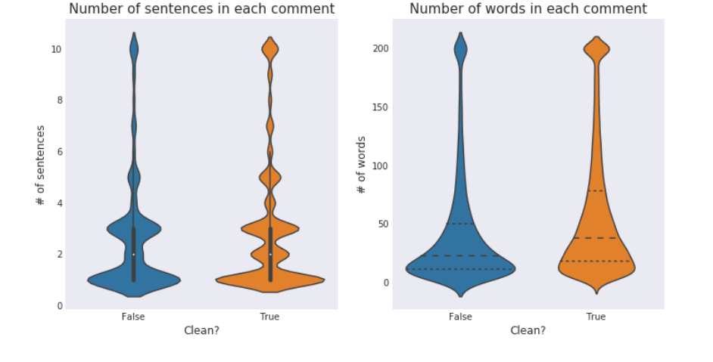
ARE LONGER COMMENTS MORE TOXIC?

Slide 11

PRE-PROCESSING
Data preprocessing is a data mining technique which is used to transform the raw data in a useful and efficient format.
Tokenize text and return a non-unique list of tokenized words found in the text
Normalize to lowercase
Strip punctuation
Lastly drop words of length < 2
Lemmatize the words
Filter non-ascii characters
Remove stop-words

Slide 12


TEXT TO VECTOR
Process of using domain knowledge to extract features from raw data via data mining techniques.
Two approaches have been used to prepare the data
We are determined to use TF-IDF to scale down the impact of tokens that occur very frequently in a given corpus and that are hence empirically less informative than features that occur in a small fraction of the training corpus
Word2vec
Glove
TF-IDF
Word Embeddings

Slide 13


N-GRAMS
An n-gram is a contiguous sequence of n items from a given sample of text or speech.
UNIGRAMS
BIGRAMS
UNIGRAMS AND BIGRAMS

Slide 14

Our main metric for measuring model performance is F1-score. Since we have 6 labels, the F1-score would be the average of 6 labels. We will also take other metrics into consideration while evaluating models, e.g., Recall
EVALUATION METRIC
F1 SCORE
RECALL

Slide 15
MODELLING
NAÏVE BAYES
LOGISTIC
REGRESSION
LSVM
NB-SVM
LSTM
Using these three as basic models

Slide 16

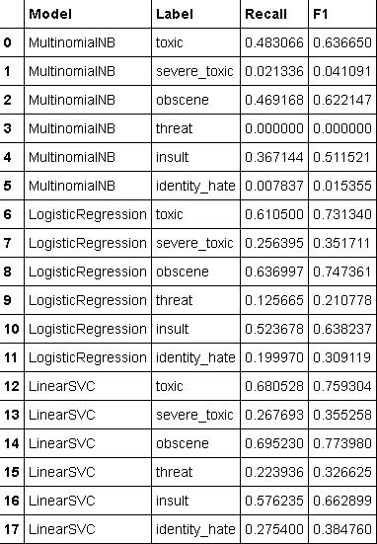

CROSS VALIDATION
We have used cross Validation to compare Naive Bayes, Logistic Regression and LinearSVC on train dataset
As a baseline model, Multinomial Naive Bayes does not perform well, especially for the threat label and identity-hate label because these two labels have the least number of observations.
The Linear SVC model and Logistic Regression model perform better

Slide 17
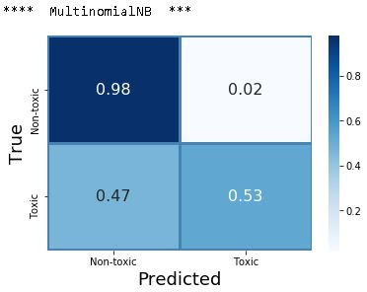
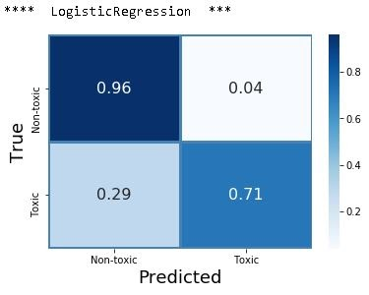
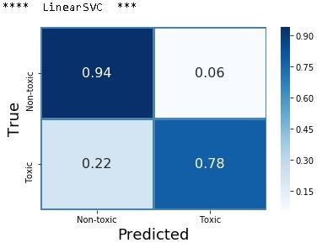

CONFUSION MATRIX
LinearSVC performs better than any other model for 'toxic' label

Slide 18



HYPERPARAMETER TUNING
Since we have 6 different labels, tuning models for each label would be time expensive, so we will use the most common label "Toxic" to tune hyperparameters.
HYPERPARAMETER TUNING WITH CLASS-WEIGHT
HYPERPARAMETER TUNING WITH GRID SEARCH
The greatest concern is the imbalanced data, we decide to manually adjust class-weight for the models to see if we can achieve better results.

Slide 19
BINARY CLASSIFICATION
We wanted to focus more on finding the toxic comments instead of classifying them under different labels so we decided to convert our problem into Binary Classification of comments into Toxic and Non Toxic.

Slide 20
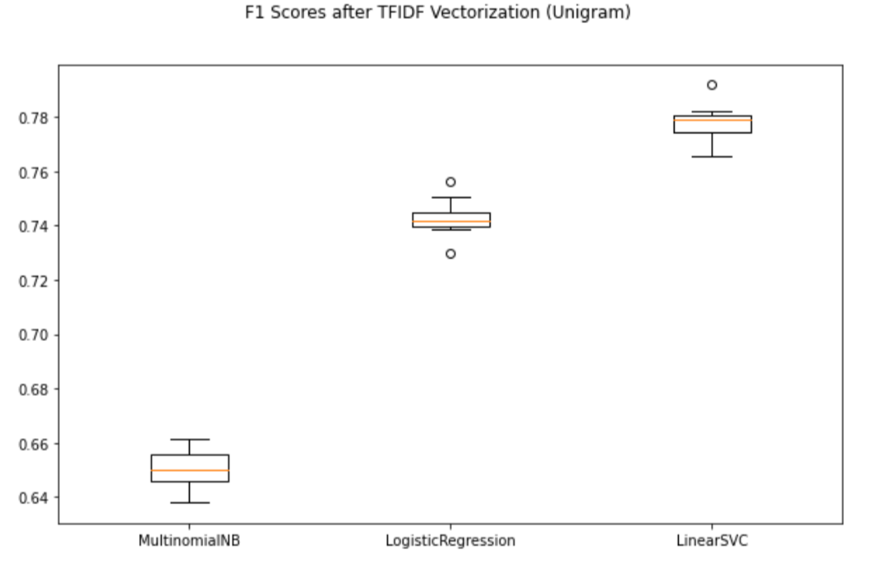
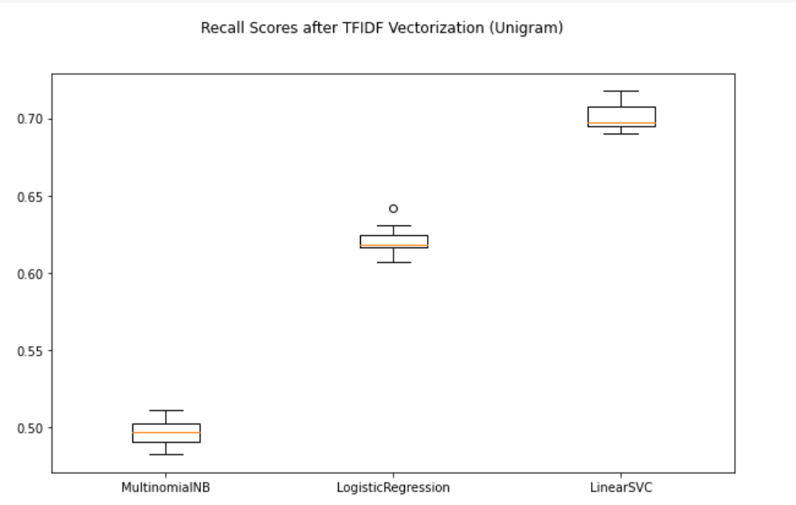
RESULTS AFTER TF-IDF
(UNIGRAM)
F1 Scores after TF-IDF Vectorization
Recall Score after TF-IDF Vectorization

Slide 21
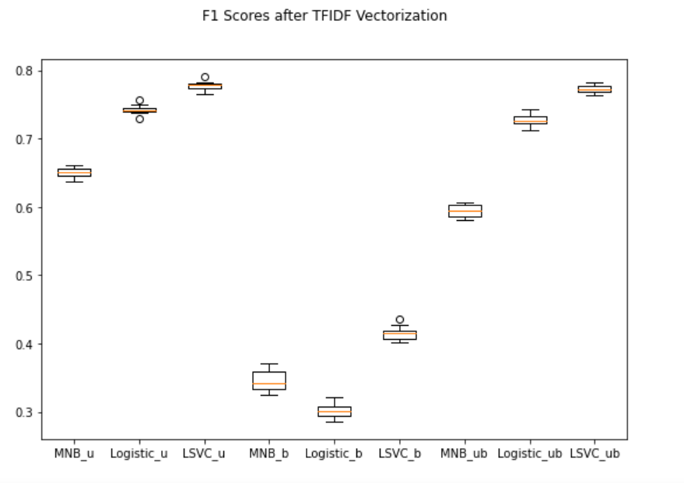
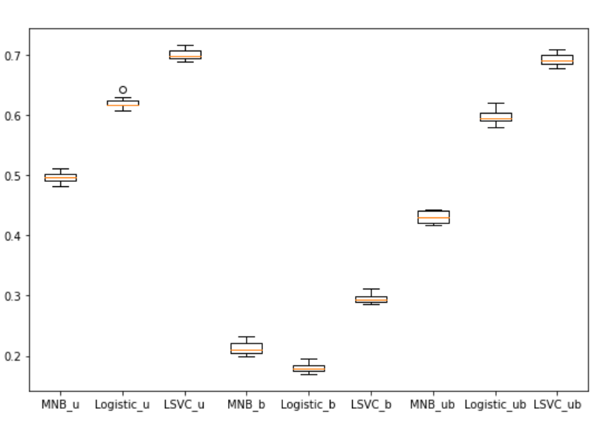
DOES OUR SCORE IMPROVE IF WE USE BIGRAMS? OR BOTH TOGETHER?
F1 Scores after TF-IDF Vectorization
Recall Score after TF-IDF Vectorization

Slide 22
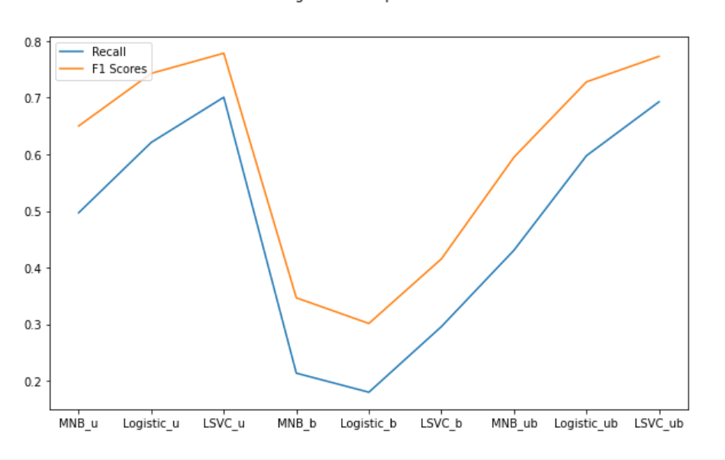
ALGORITHM COMPARISON

Slide 23
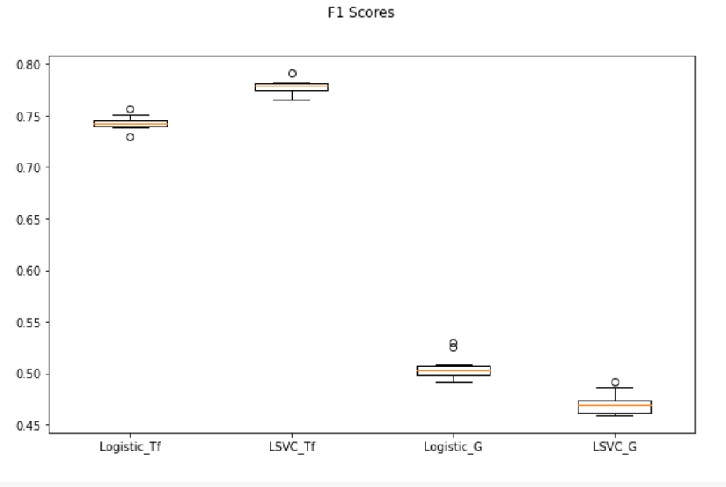
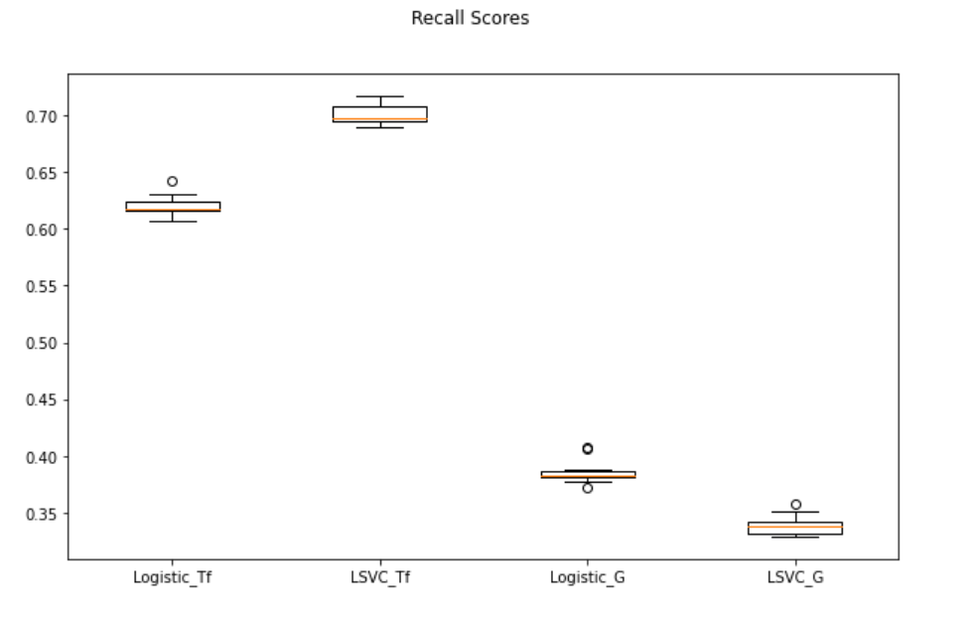
WHAT IF WE USE PRE-TRAINED
WORD VECTORS
F1 Scores
Recall Scores

Slide 24
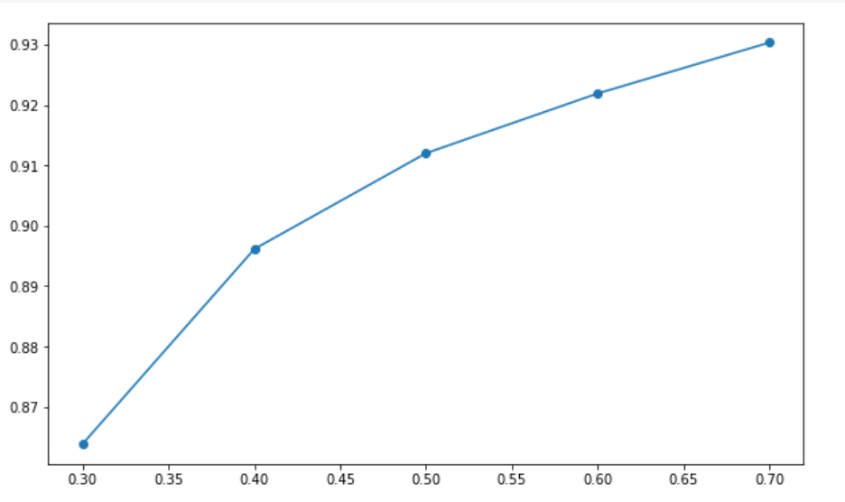
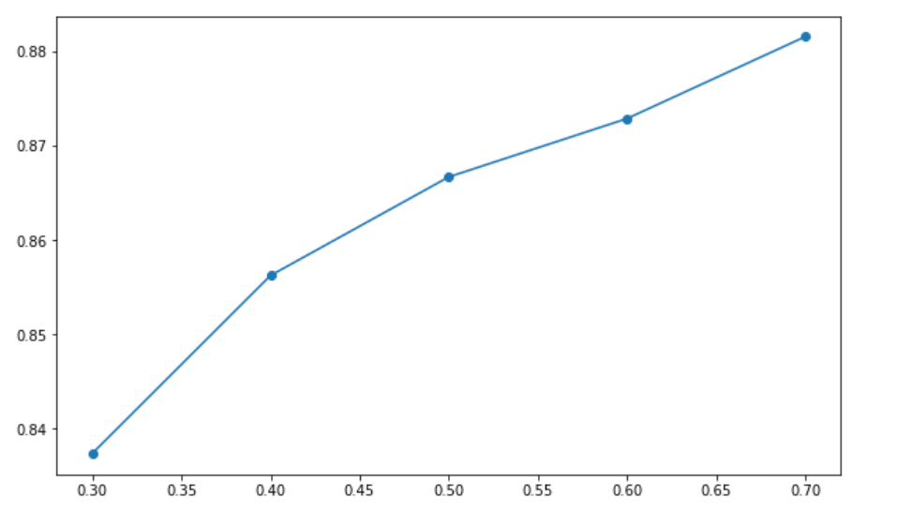
IMBALANCED DATASET
F1 Scores vs diff Over-Sampling strategy
F1 Scores vs diff Under-Sampling
strategy

Slide 25
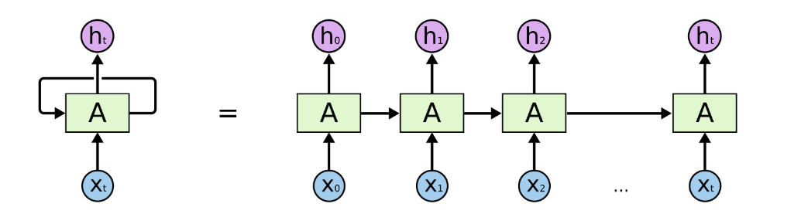
LSTM
Unrolled recurrent neural network.

Slide 26
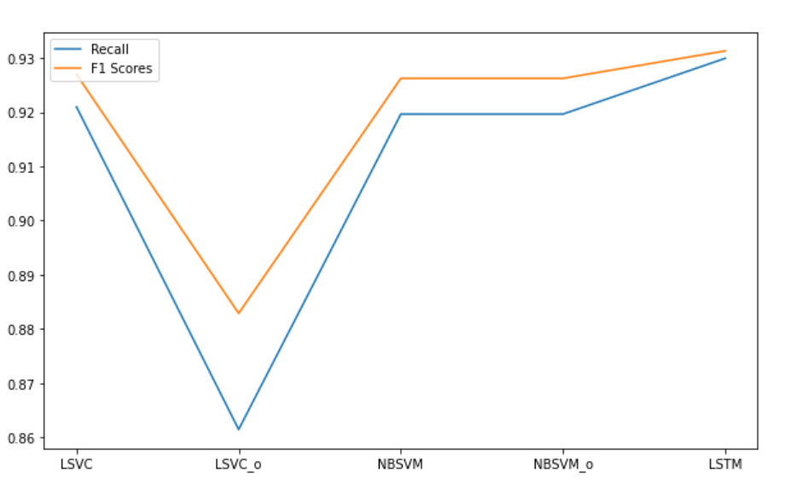
Final Battle

Slide 27


FUTURE IMPROVEMENTS
Try more ways of vectorizing text data.
Go deeper on feature engineering: Spelling corrector, Sentiment scores, etc.
Advanced models (e.g., lightgbm).
Ensemble model (e.g., stacking).
Advanced hyperparameter tuning techniques (e.g., Bayesian Optimization).

Slide 28
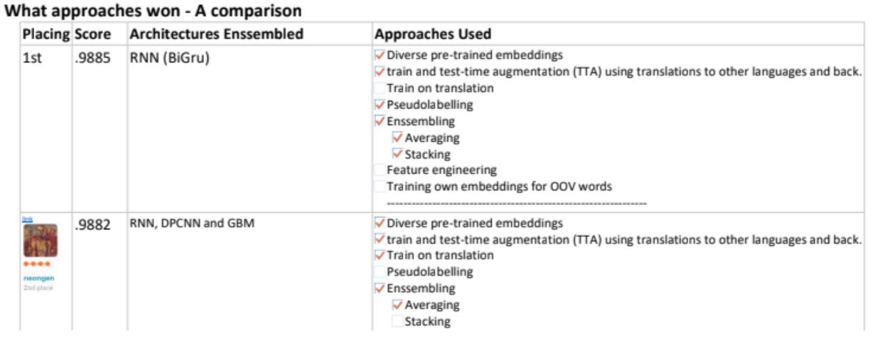
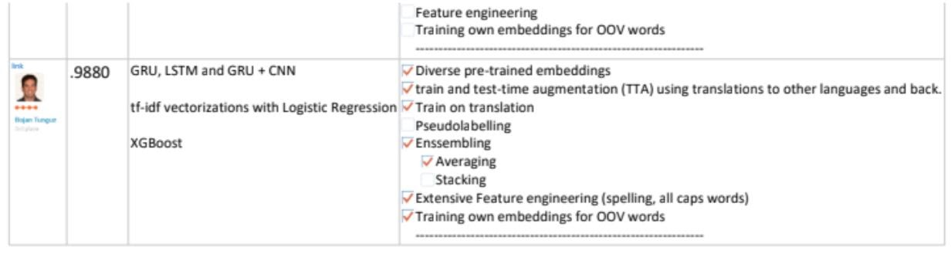
B
O
N
U
S
S
L
I
D
E

Slide 29


